Slide 1
Project Planning

Slide 2
Estimation techniques

Slide 3
Estimation techniques
Organizations need to make software effort and cost estimates.
There are two types of technique that can be used to do this:
Experience-based techniques The estimate of future effort requirements is based on the manager’s experience of past projects and the application domain. Essentially, the manager makes an informed judgment of what the effort requirements are likely to be.
Algorithmic cost modeling In this approach, a formulaic approach is used to compute the project effort based on estimates of product attributes, such as size, and process characteristics, such as experience of staff involved.

Slide 4
Experience-based approaches
Experience-based techniques rely on judgments based on experience of past projects and the effort expended in these projects on software development activities.
Typically, you identify the deliverables to be produced in a project and the different software components or systems that are to be developed.
You document these in a spreadsheet, estimate them individually and compute the total effort required.
It usually helps to get a group of people involved in the effort estimation and to ask each member of the group to explain their estimate.

Slide 5
Problem with experience-based approaches
The difficulty with experience-based techniques is that a new software project may not have much in common with previous projects.
Software development changes very quickly and a project will often use unfamiliar techniques.
If you have not worked with these techniques, your previous experience may not help you to estimate the effort required, making it more difficult to produce accurate costs and schedule estimates.

Slide 6
Algorithmic cost modelling
Cost is estimated as a mathematical function of product, project and process attributes whose values are estimated by project managers:
Effort = A * Size^{B} * M
A is an organisation-dependent constant, B reflects the disproportionate effort for large projects and M is a multiplier reflecting product, process and people attributes.
The most commonly used product attribute for cost
estimation is code size.
Most models are similar but they use different values for A, B and M.

Slide 7
Estimation accuracy
The size of a software system can only be known
accurately when it is finished.
Several factors influence the final size
Use of reused systems and components;
Programming language;
Distribution of system.
As the development process progresses then the size estimate becomes more accurate.

Slide 8
Effectiveness of algorithmic models
Algorithmic cost models are a systematic way to estimate the effort required to develop a system. However, these models are complex and difficult to use.
There are many attributes and considerable scope for uncertainty in estimating their values.
This complexity means that the practical application of algorithmic cost modeling has been limited to a relatively small number of large companies, mostly working in defense and aerospace systems engineering.

Slide 9
Albrecht/IFPUG function points
Albrecht worked at IBM and needed a way of measuring the relative productivity of different programming languages.
Needed some way of measuring the size of an application without counting lines of code.
Identified five types of component or functionality in an information system
Counted occurrences of each type of functionality in order to get an indication of the size of an information system
Notes:
Different programming languages have different degrees of ‘power’ which relate to the ratio between the length of programming commands and the amount of processing they create. This is analogous to trying to assess the productivity of bricklayers where different bricklayers work with bricks of different sizes. One way of dealing with this problem is to say that what is important is the size of the wall being built not the number of bricks it contains. FPs are way of measuring the amount of functionality in an application without counting the lines of code in the application.

Slide 10
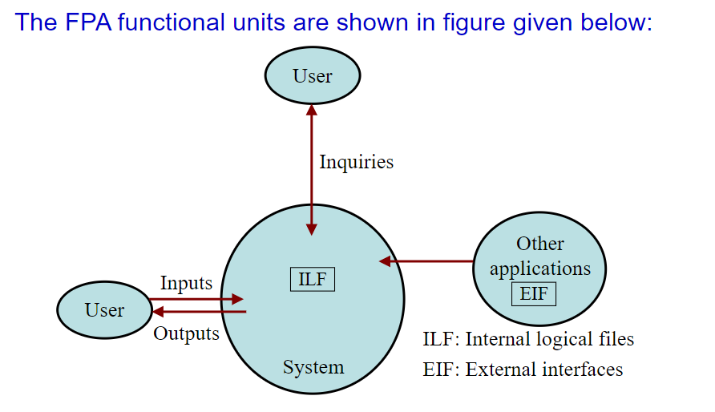

Slide 11
Albrecht/IFPUG function points - continued
Five function types
Logical interface file (LIF) types – equates roughly to a datastore in systems analysis terms. Created and accessed by the target system
External interface file types (EIF) – where data is retrieved from a datastore which is actually maintained by a different application.

Slide 12
Albrecht/IFPUG function points - continued
External input (EI) types – input transactions which update internal computer files
External output (EO) types – transactions which extract and display data from internal computer files. Generally involves creating reports.
External inquiry (EQ) types – user initiated transactions which provide information but do not update computer files. Normally the user inputs some data that guides the system to the information the user needs.
Notes:
Section 5.10 Page 114

Slide 13
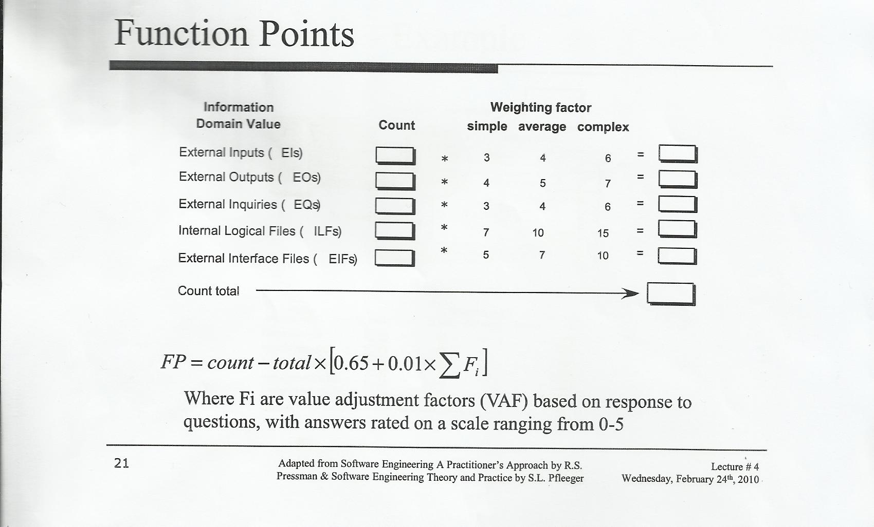
Function Point
FP= UFP * VAF

Slide 14
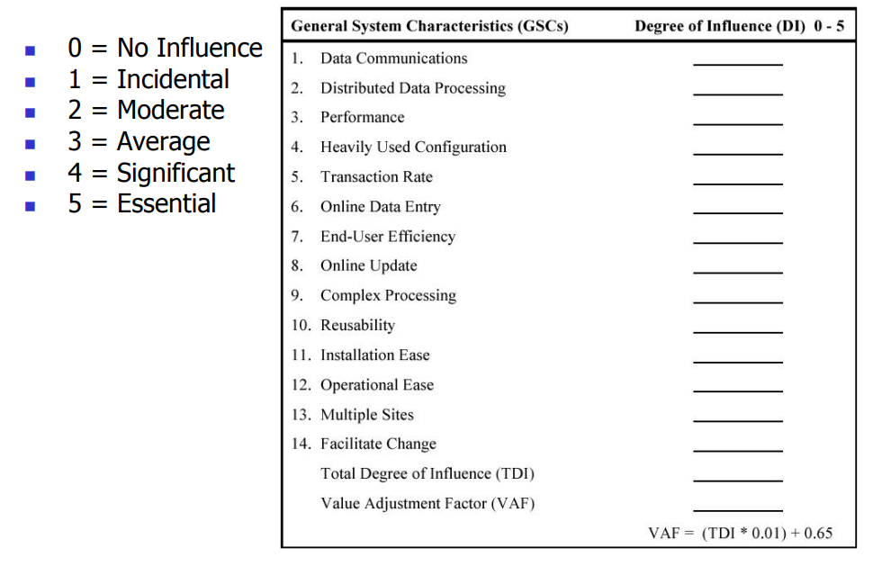
VAF Calculation

Slide 15
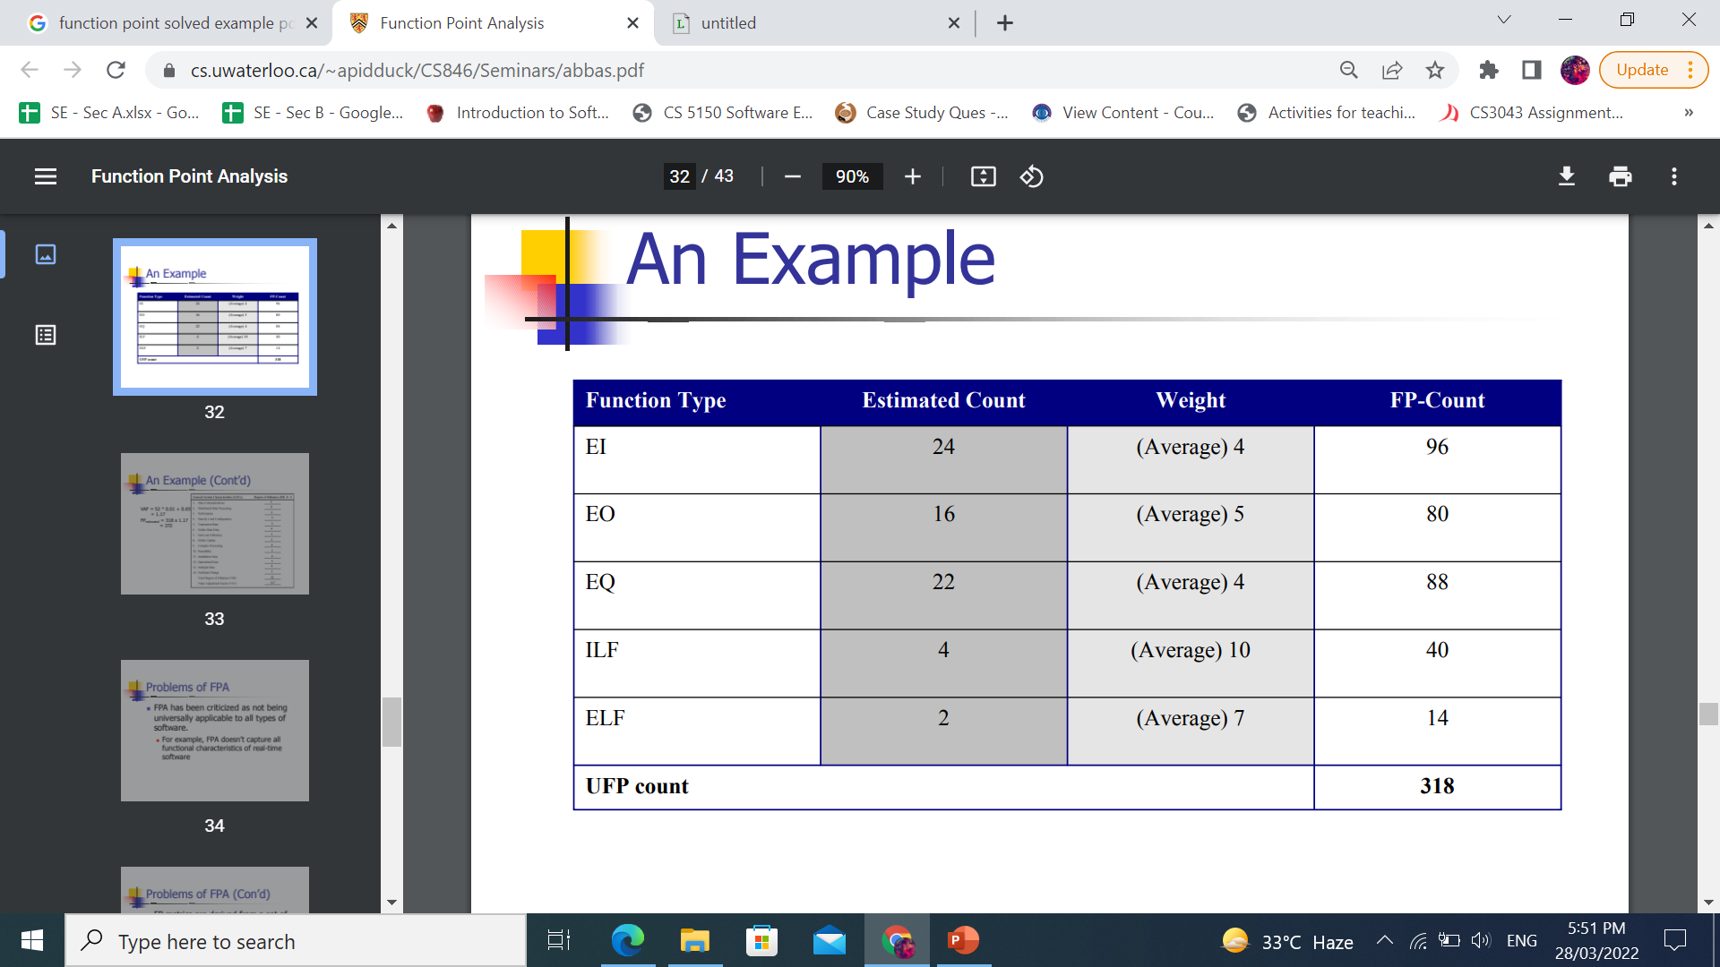
Example

Slide 16
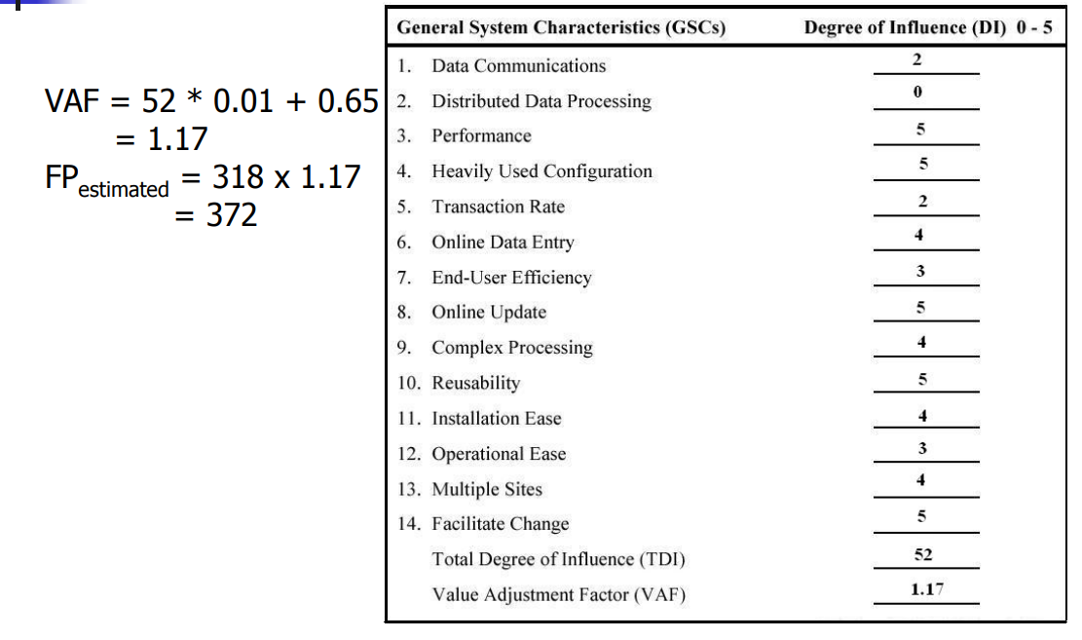
Example
VAF = (TDI * 0.01) + 0.65.

Slide 17
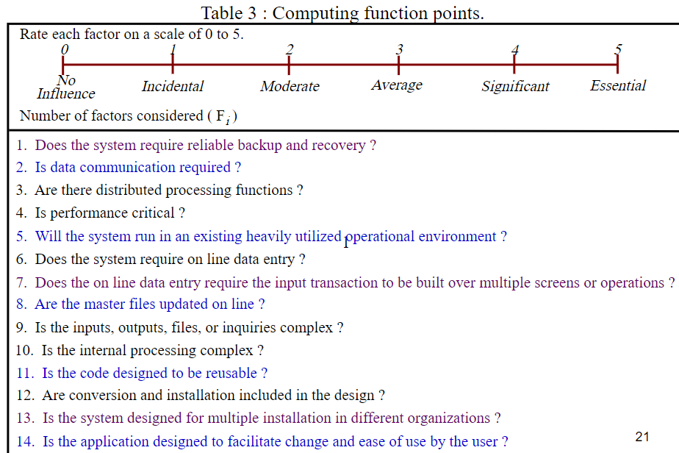

Slide 18
Function points Mark II
Developed by Charles R. Symons
‘Software sizing and estimating - Mk II FPA’, Wiley & Sons, 1991.
Builds on work by Albrecht
Work originally for CCTA:
should be compatible with SSADM; mainly used in UK
has developed in parallel to IFPUG FPs
A simpler method
Notes:
Once again, just a reminder that the lecture is just an overview of concepts. Mark II FPs is a version of function points developed in the UK and is only used by a minority of FP specialists. The US-based IFPUG method (developed from the original Albrecht approach) is more widely used. I use the Mark II version because it has simpler rules and thus provides an easier introduction to the principles of FPs. Mark II FPs are explained in more detail in Section 5.11. The IFPUG rules are really quite tricky in places and for the full rules it is best to consult IFPUG documentation.

Slide 19
Function points for embedded systems
Mark II function points, IFPUG function points were designed for information systems environments
COSMIC FPs attempt to extend concept to embedded systems
Embedded software seen as being in a particular ‘layer’ in the system
Communicates with other layers and also other components at same level
Notes:
Attempts have been made to extend IFPUG FPs to real-time and embedded systems, but this has not been very convincing (IMHO).
Embedded software component is seen as at a particular level in the system. It receives calls for services from a higher layer and requests services from lower layers. It will receive responses from lower levels and will send responses to higher levels.

Slide 20
COCOMO81
Based on industry productivity standards - database is constantly updated
Allows an organization to benchmark its software development productivity
Basic model
effort = c x size^{k}
C and k depend on the type of system: organic, semi-detached, embedded
Size is measured in ‘kloc’ ie. Thousands of lines of code
Notes:
Recall that the aim of this lecture is to give an overview of principles. COCOMO81 is the original version of the model which has subsequently been developed into COCOMO II some details of which are discussed in Section 5.13. For full details read Barry Boehm et al. Software estimation with COCOMO II Prentice-Hall 2002.

Slide 21
3 types of COCOMO:
1- Basic Cocomo Model
2- Intermediate Cocomo Model
3- Detailed Cocomo Model

Slide 22
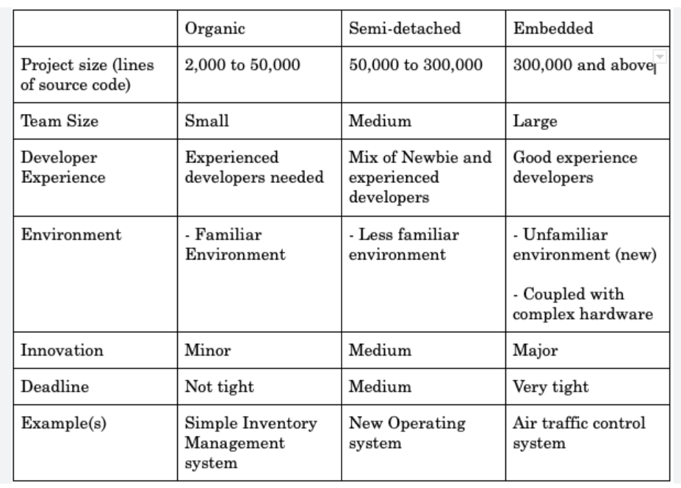
Difference

Slide 23
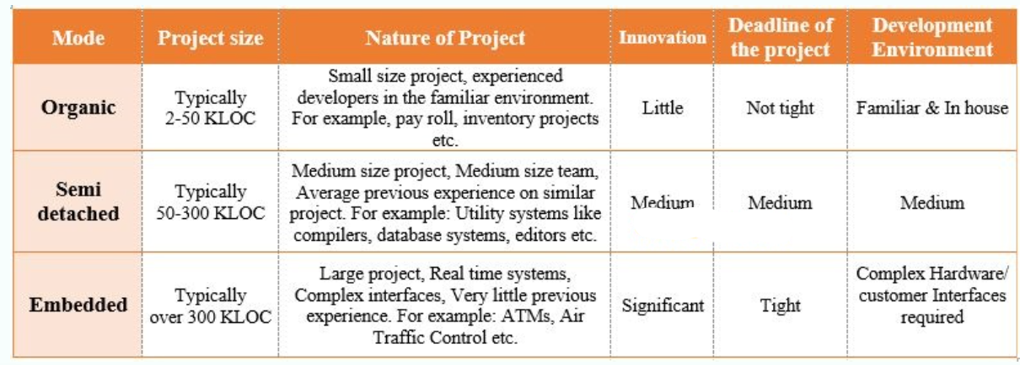
FYI:

Slide 24
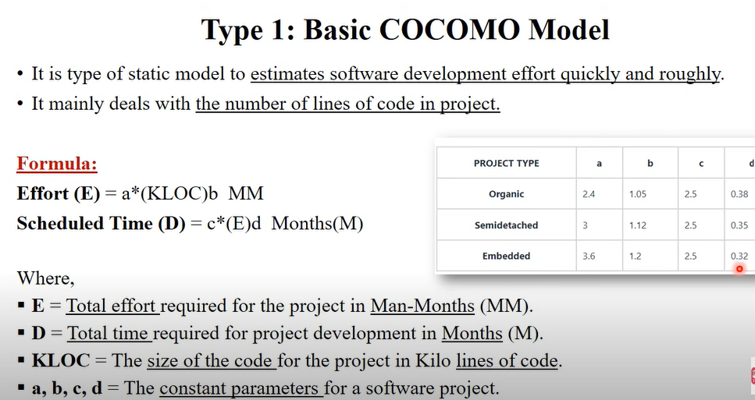
1- Basic Cocomo

Slide 25
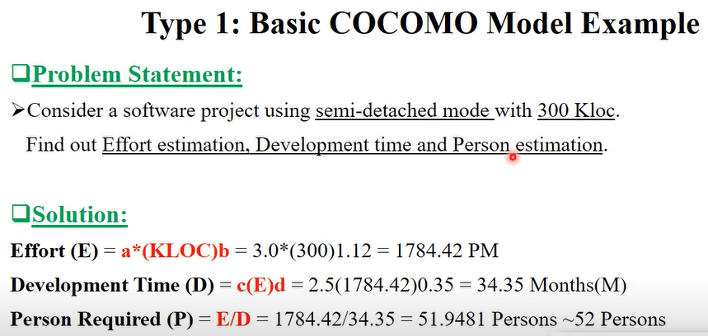
1- Example

Slide 26
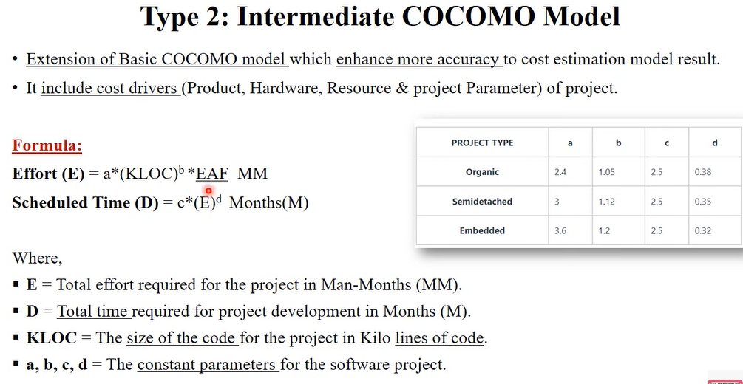
2- Intermediate Cocomo Model

Slide 27
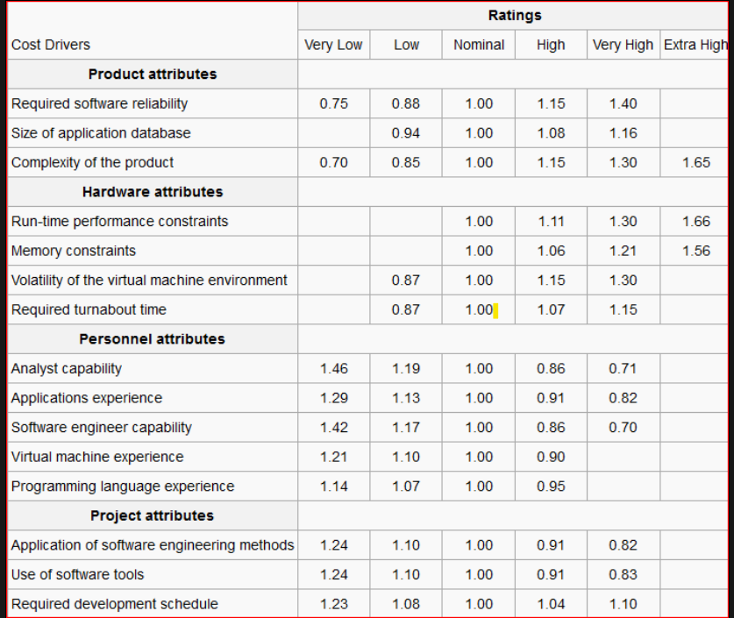
EAF Table
Notes:
The Effort Adjustment Factor (EAF) is determined by multiplying the effort multipliers associated with each of the 15 attributes.

Slide 28
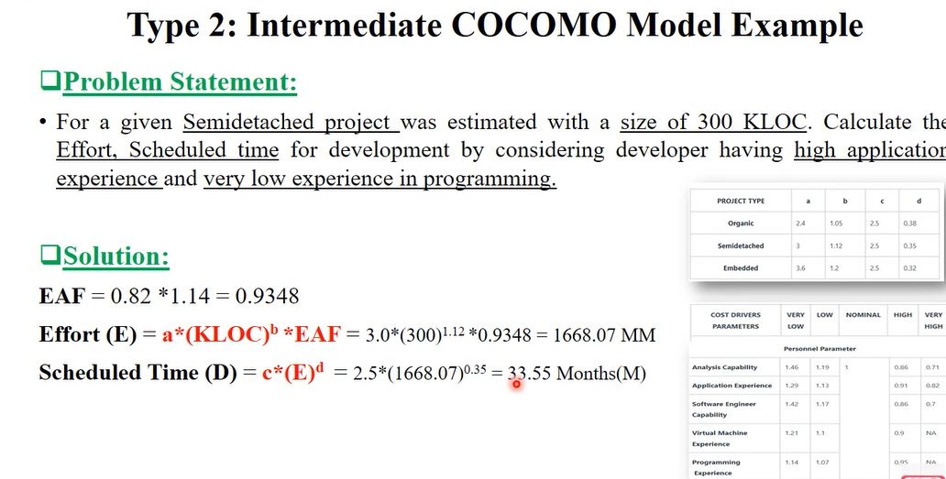
2- Example

Slide 29
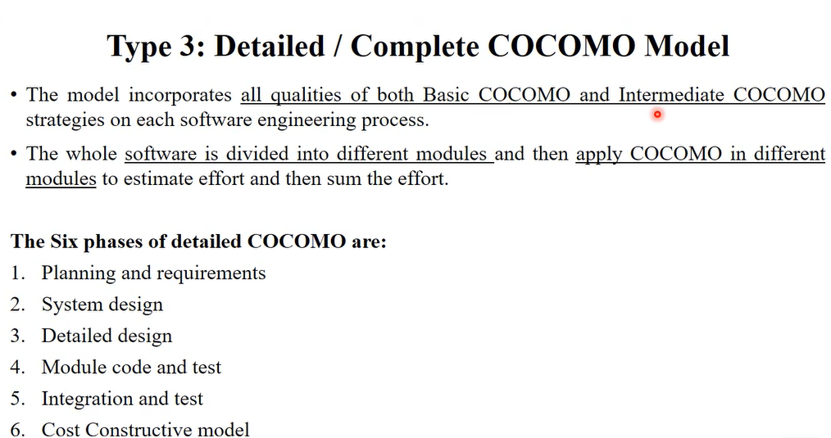
3- Detailed Cocomo Model

Slide 30
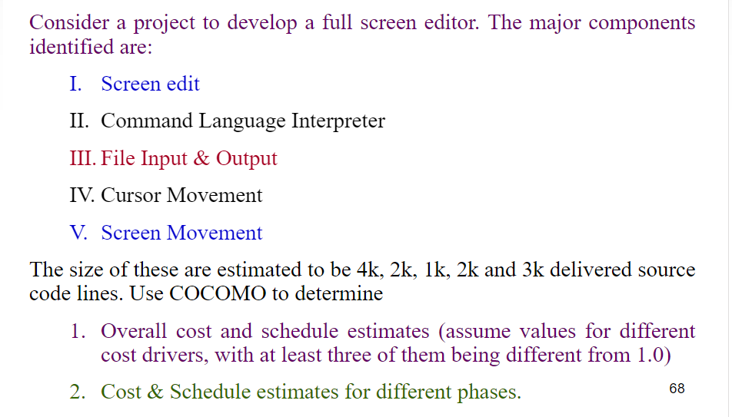
3- Example

Slide 31
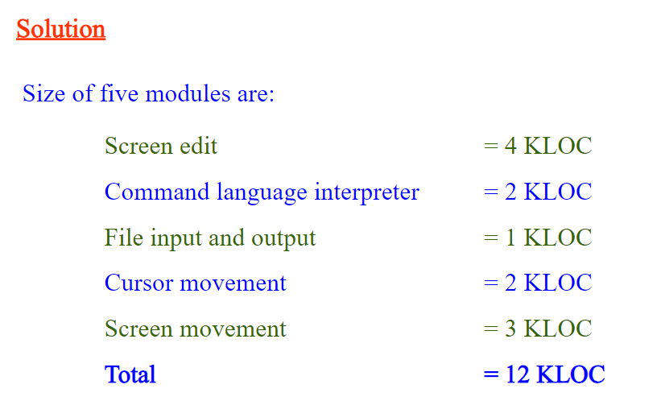
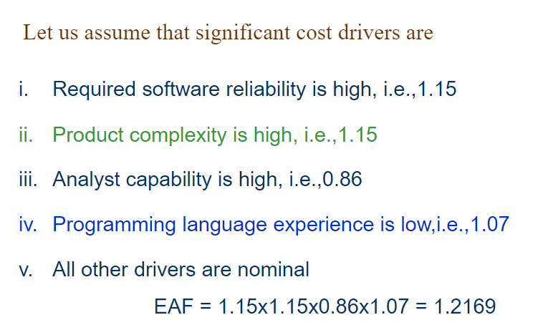

Slide 32
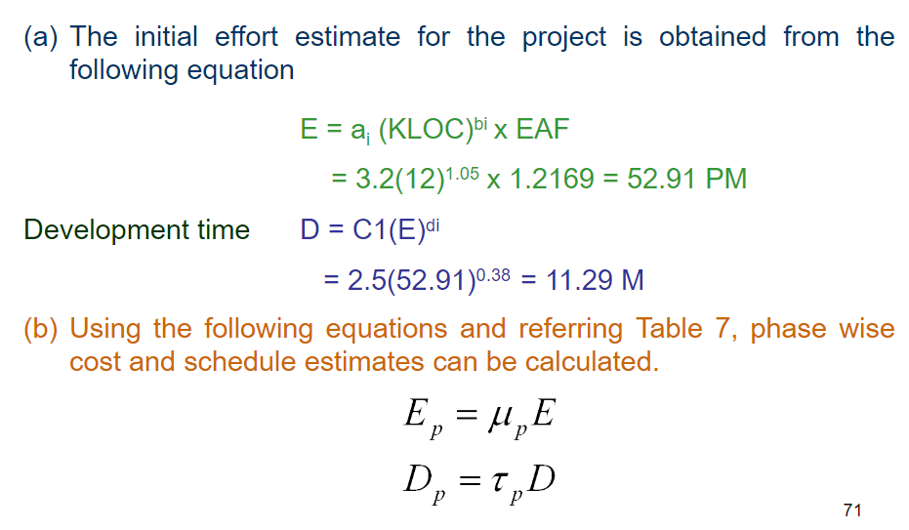

Slide 33
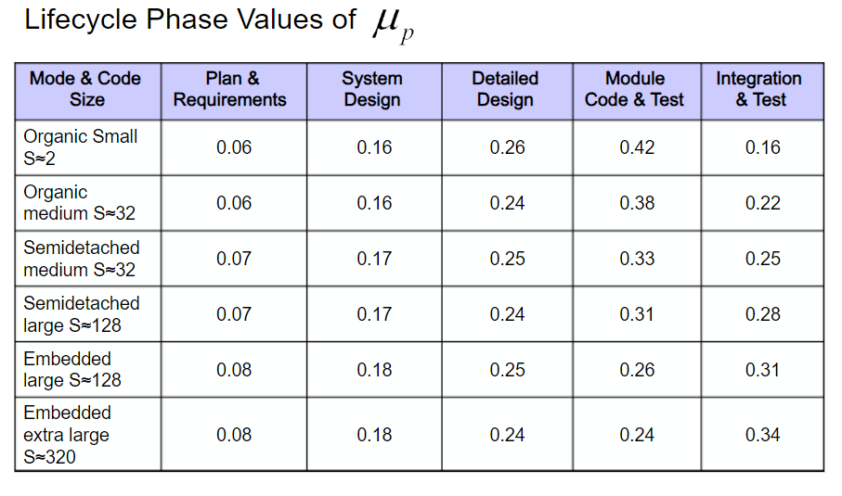

Slide 34
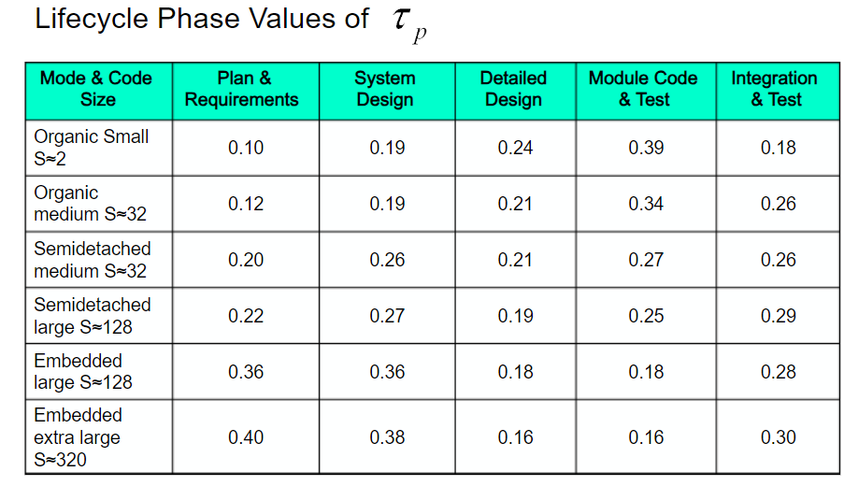

Slide 35
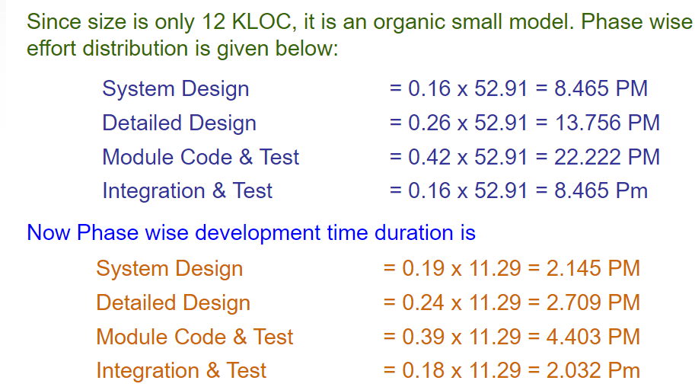

Slide 36
COCOMO 2 models
COCOMO 2 incorporates a range of sub-models that produce increasingly detailed software estimates.
The sub-models in COCOMO 2 are:
Application composition model. Used when software is composed from existing parts.
Early design model. Used when requirements are available but design has not yet started.
Reuse model. Used to compute the effort of integrating reusable components.
Post-architecture model. Used once the system architecture has been designed and more information about the system is available.

Slide 37
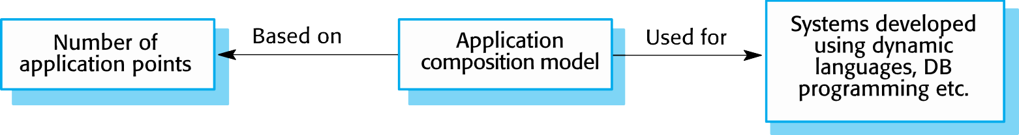
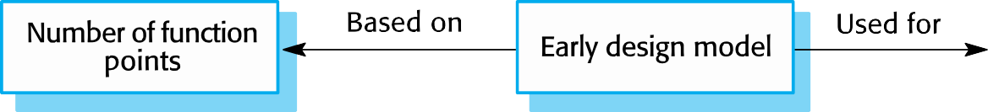
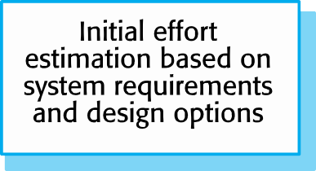
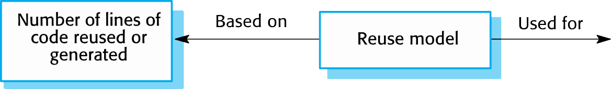
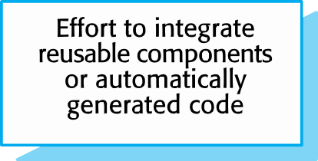
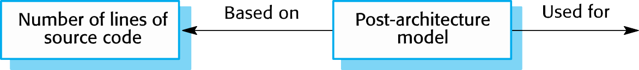

COCOMO estimation models

